Slide 1
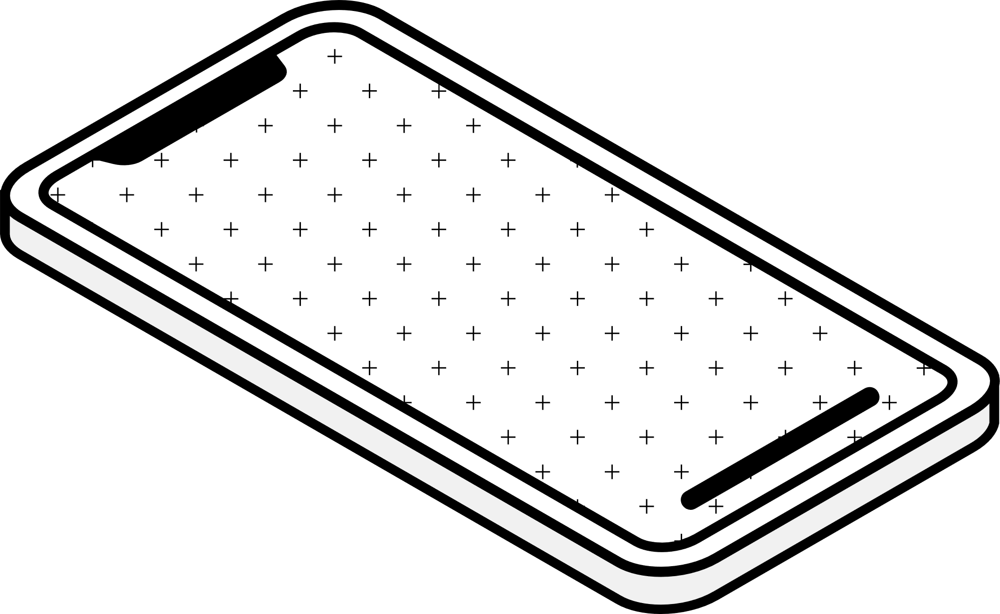
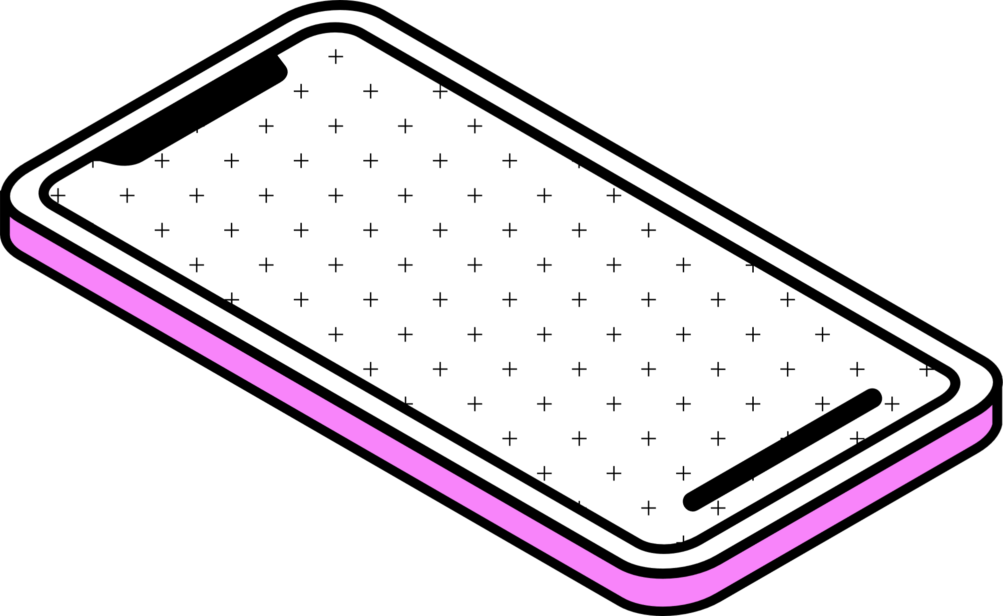
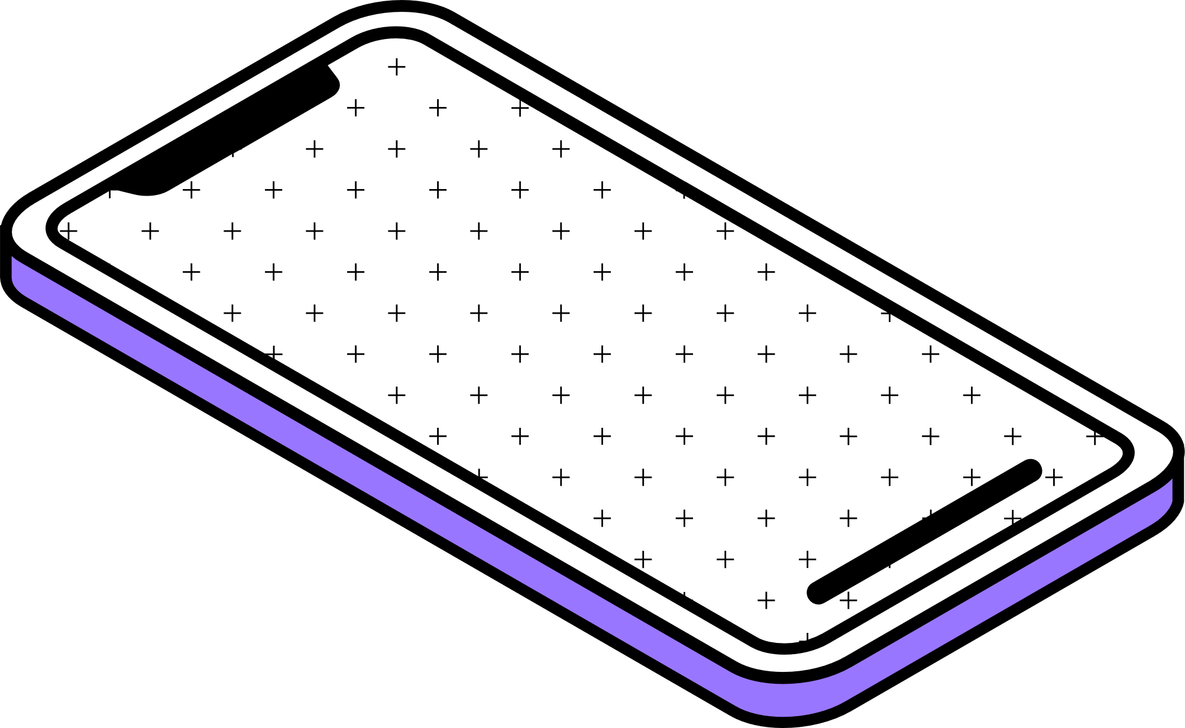
NEPAL ENGINEERING COLLEGE
AR Store
Samar Shrestha (019-370)
Sushant Byanju Shrestha (019-392)
Umesh Shrestha (019-394)

Slide 2

Introduction
Existing System
Proposed System
Aim
Objectives
Hardware and Software Requirement
CONTENTS
AR STORE
System Design
Advantages
Future Work

Slide 3
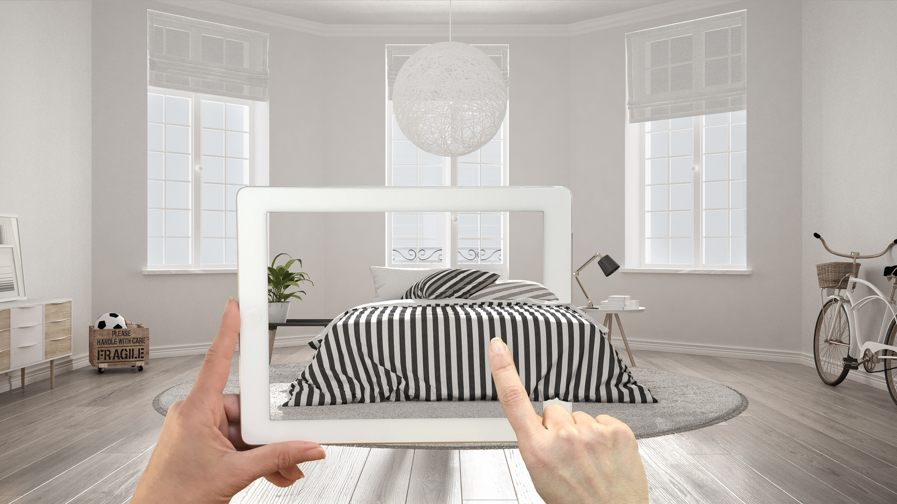
AR STORE
in a nutshell
Augmented Reality (AR) is revolutionizing the ecommerce landscape, offering an immersive shopping experience. By blending digital and physical worlds, AR empowers customers to interact with virtual furniture models in their real spaces before purchase.
Page 01

Slide 4



Existing System Drawbacks
Time for a revolutionary change
Limited Visualization
Disconnect from Physical World
Unsatisfactory Customer Experience
Traditional ecommerce lacks interactive product visualization, leading to uncertainty and high return rates.
Online shoppers cannot accurately envision how furniture will look and fit in their living spaces.
Without AR, customers face challenges in making informed purchase decisions, hindering satisfaction.
Page 02

Slide 5
Proposed AR-Powered
Ecommerce Platform
Immersive AR Integration
Seamlessly integrates AR technology for interactive furniture visualization.
Enables customers to view 3D product models in their physical environments.
Enhanced Decision-Making
Empowers customers to make confident purchase decisions.
Reduces product returns by accurately showcasing furniture fit and aesthetics.
Unveils a world of immersive possibilities
Industry-Leading Innovation
Pioneers the future of online furniture shopping with cutting-edge AR technology.
Establishes a competitive advantage through superior customer experiences.
Page 03

Slide 6
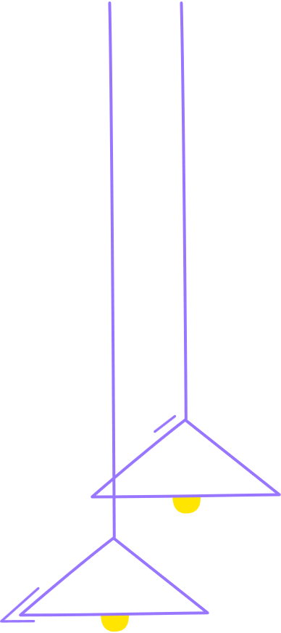



Aim
Revolutionize online shopping
Immersive AR Experiences
Personalized Product Visualization
Interactive Product Exploration
Deliver captivating AR-powered shopping journeys, fostering customer engagement and interest.
Empower customers to visualize furniture in their unique living spaces, creating personalized shopping experiences.
Enable customers to interact with 3D models, rotate, and view furniture from all angles for a comprehensive understanding.
Page 04

Slide 7




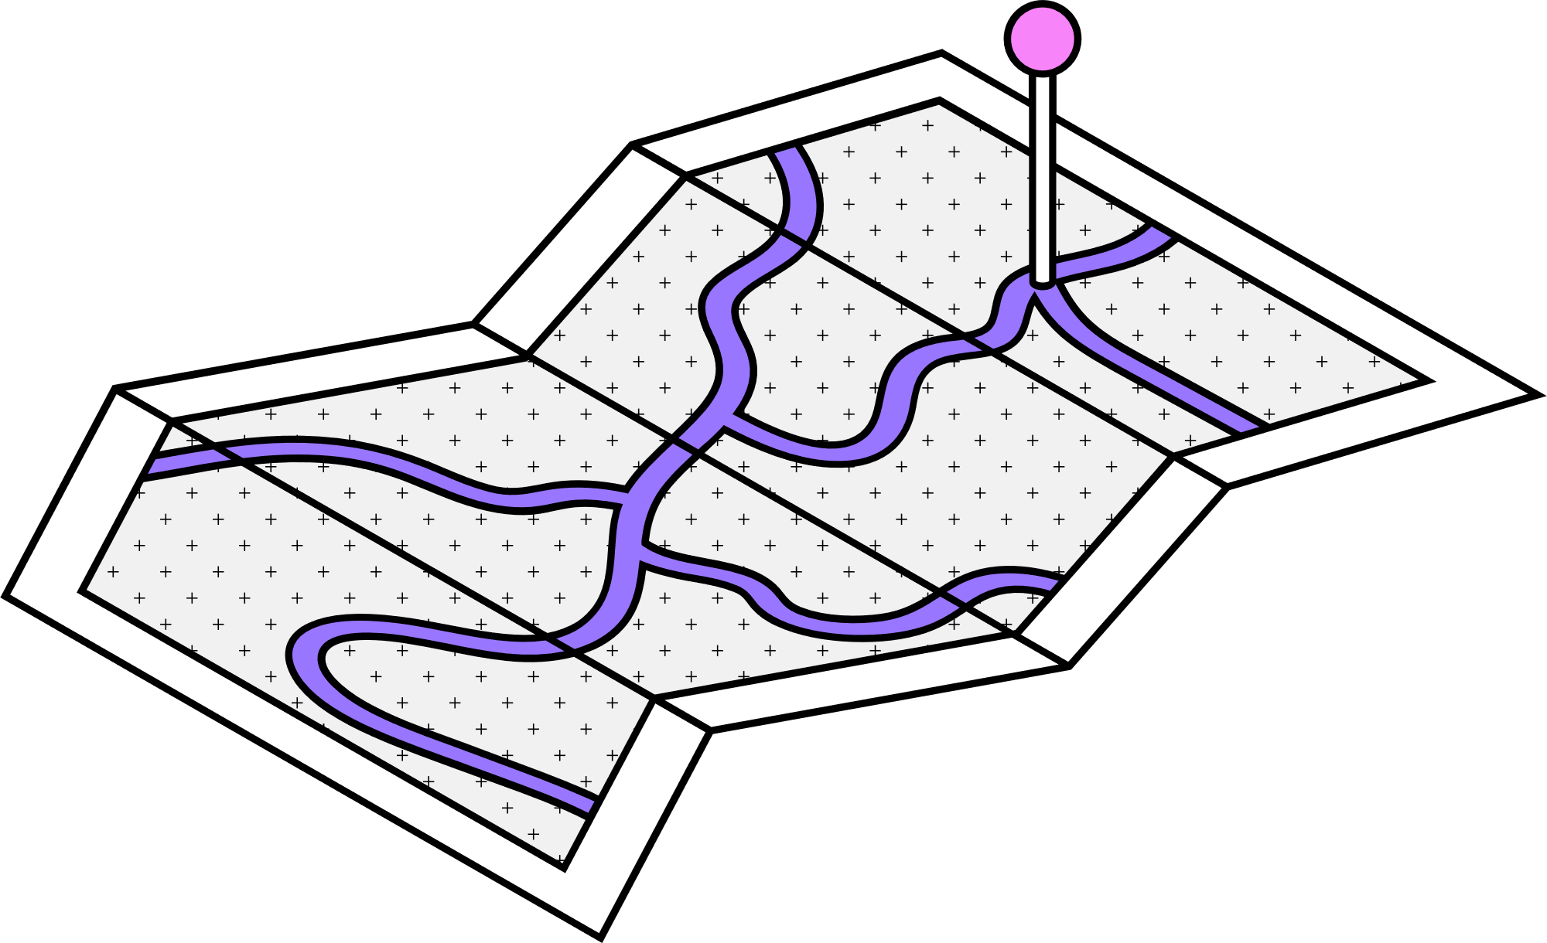
Key Objectives
Precise Tracking
Seamless Integration
Optimized Rendering
High Performance
Implement VIO and SLAM for accurate tracking and mapping of surroundings.
Integrate AR functionality seamlessly into the ecommerce platform frontend.
Utilize Three.js and WebXR for efficient 3D model rendering and AR experiences.
Ensure scalability and optimal performance for smooth AR-powered shopping.
Page 05

Slide 8
Hardware Requirements
Software Requirements
Devices with LiDAR sensors for precise spatial mapping
Cameras with depth sensing capabilities
Compatible with various form factors (mobile, tablet)
Three.js library for 3D model rendering
ARCore and ARKit for advanced AR functionalities
Optimized rendering techniques for efficient performance
High-performance GPUs for efficient AR rendering
WebXR Device API for enabling AR experiences
Page 06

Slide 9
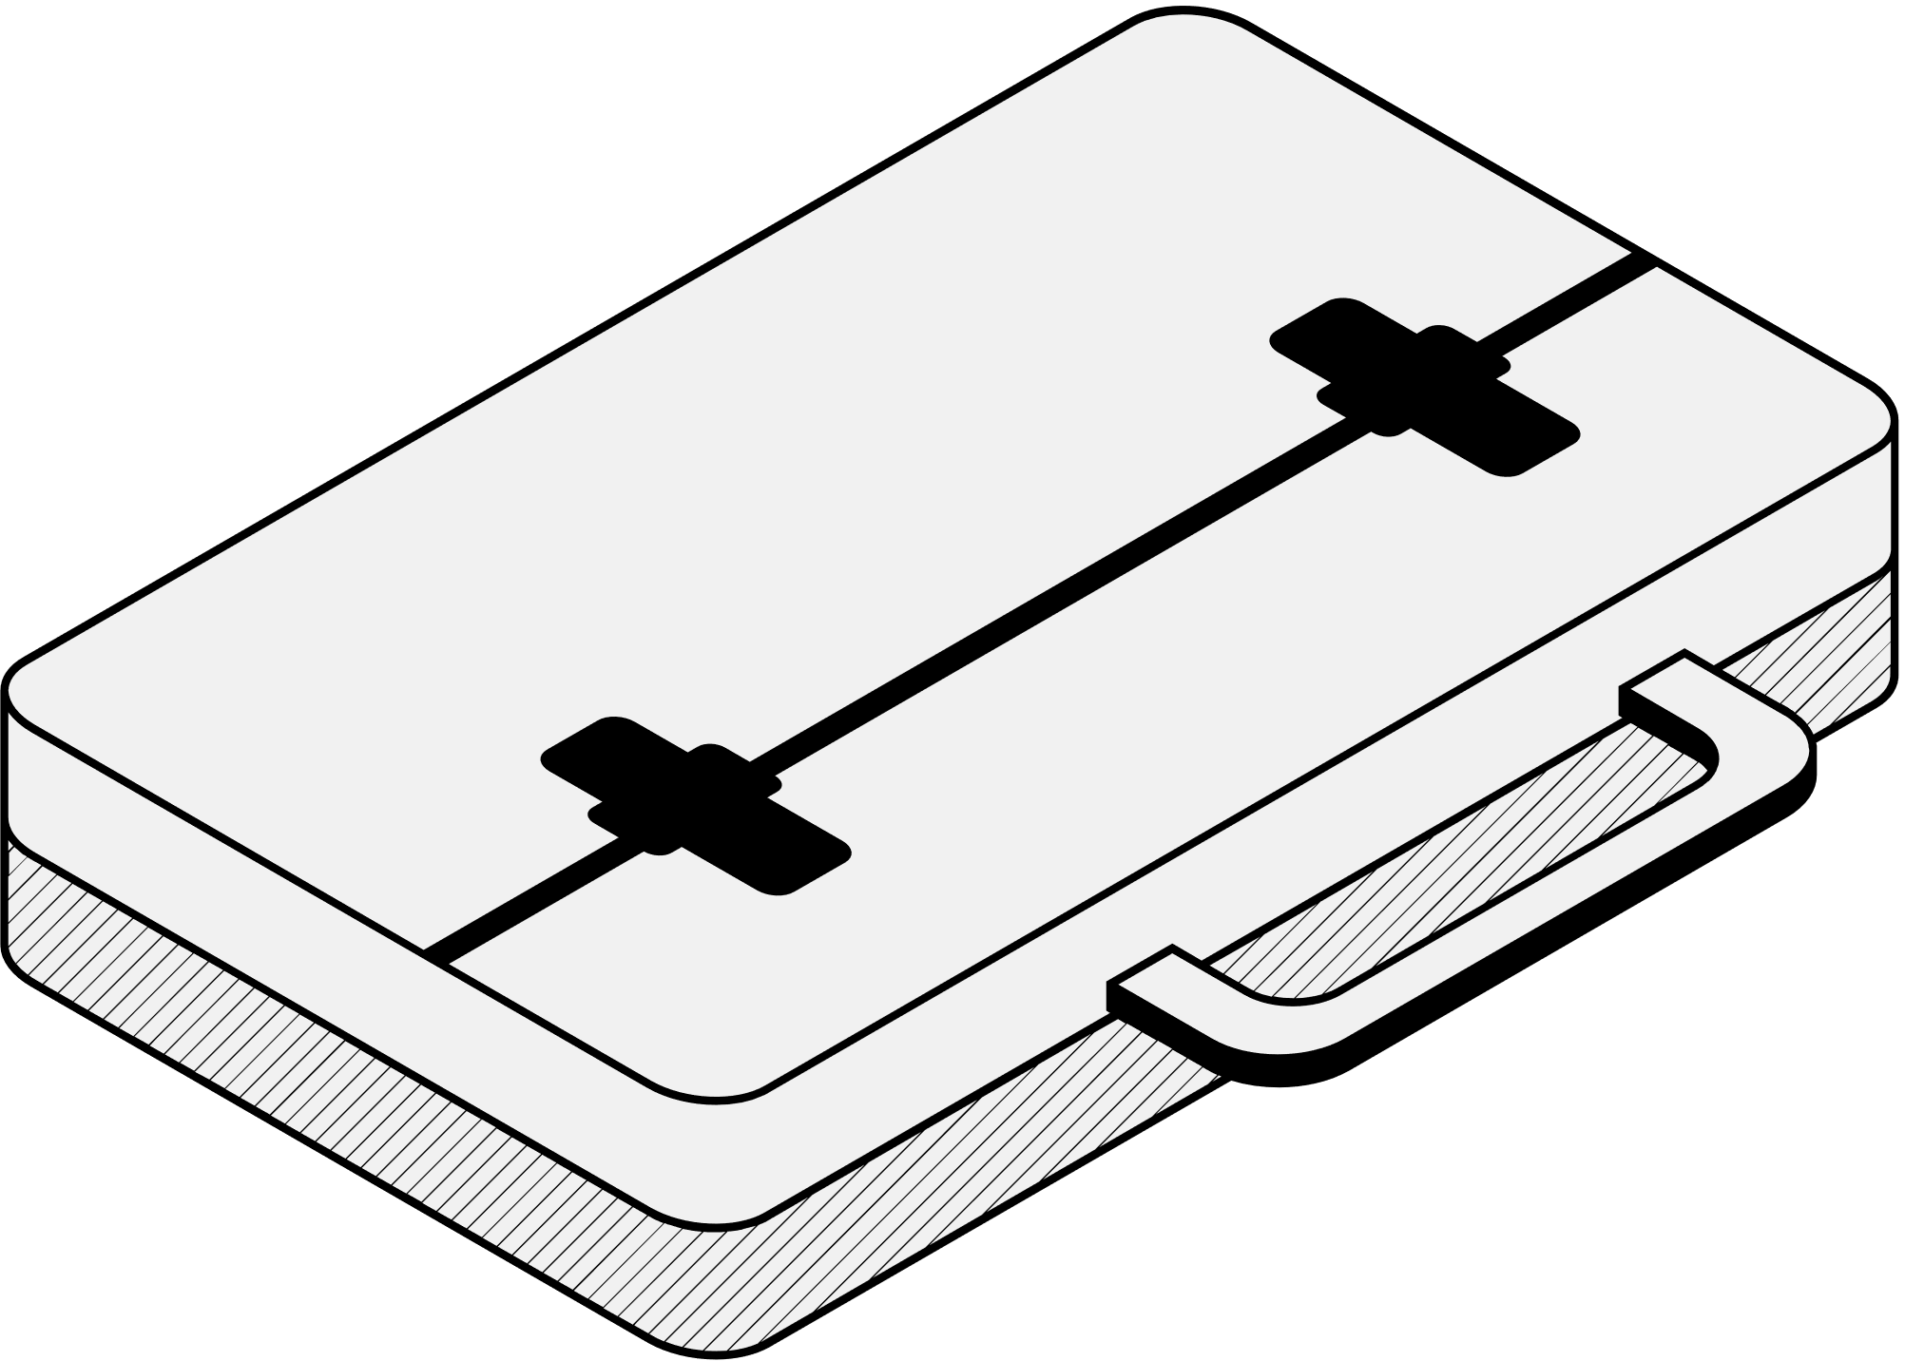
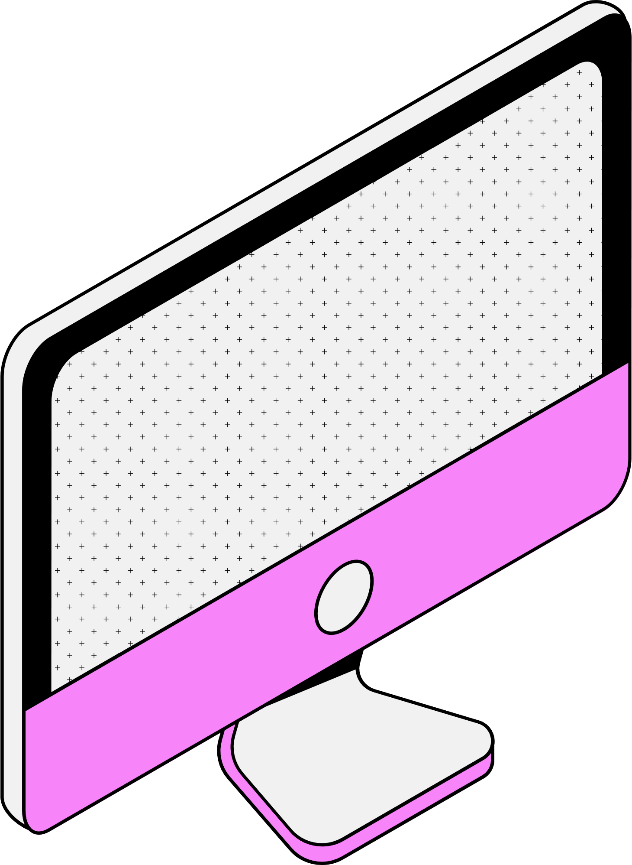
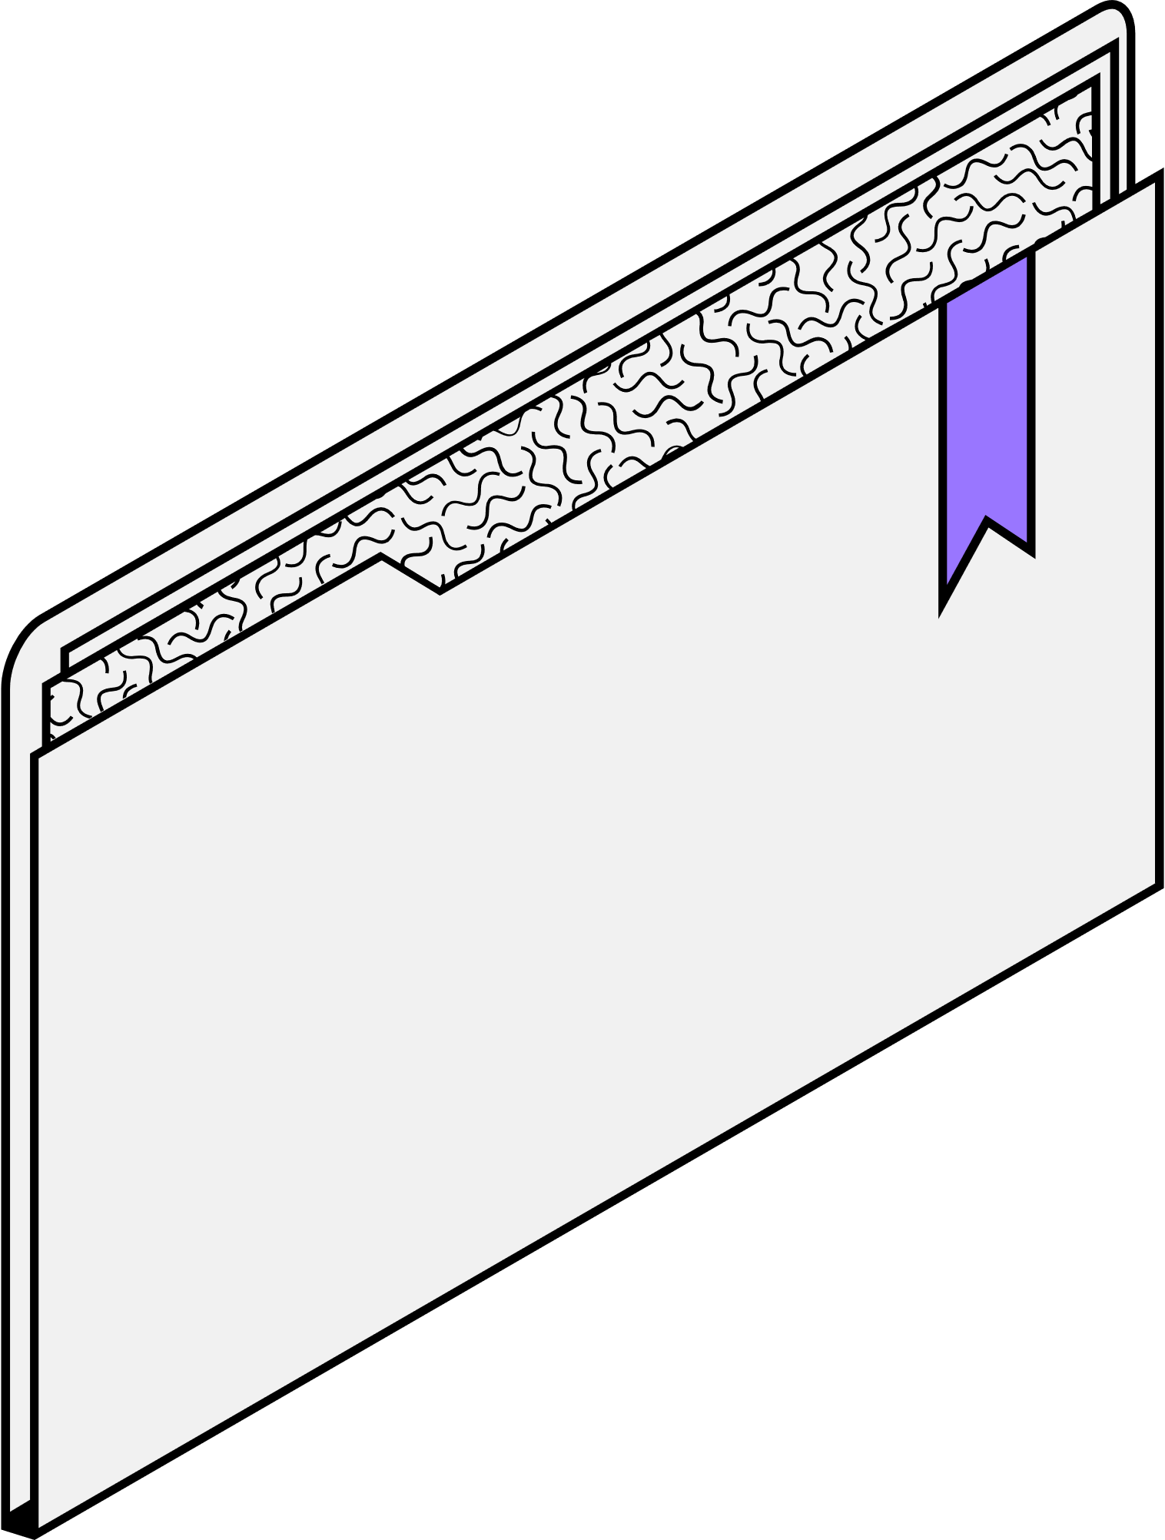
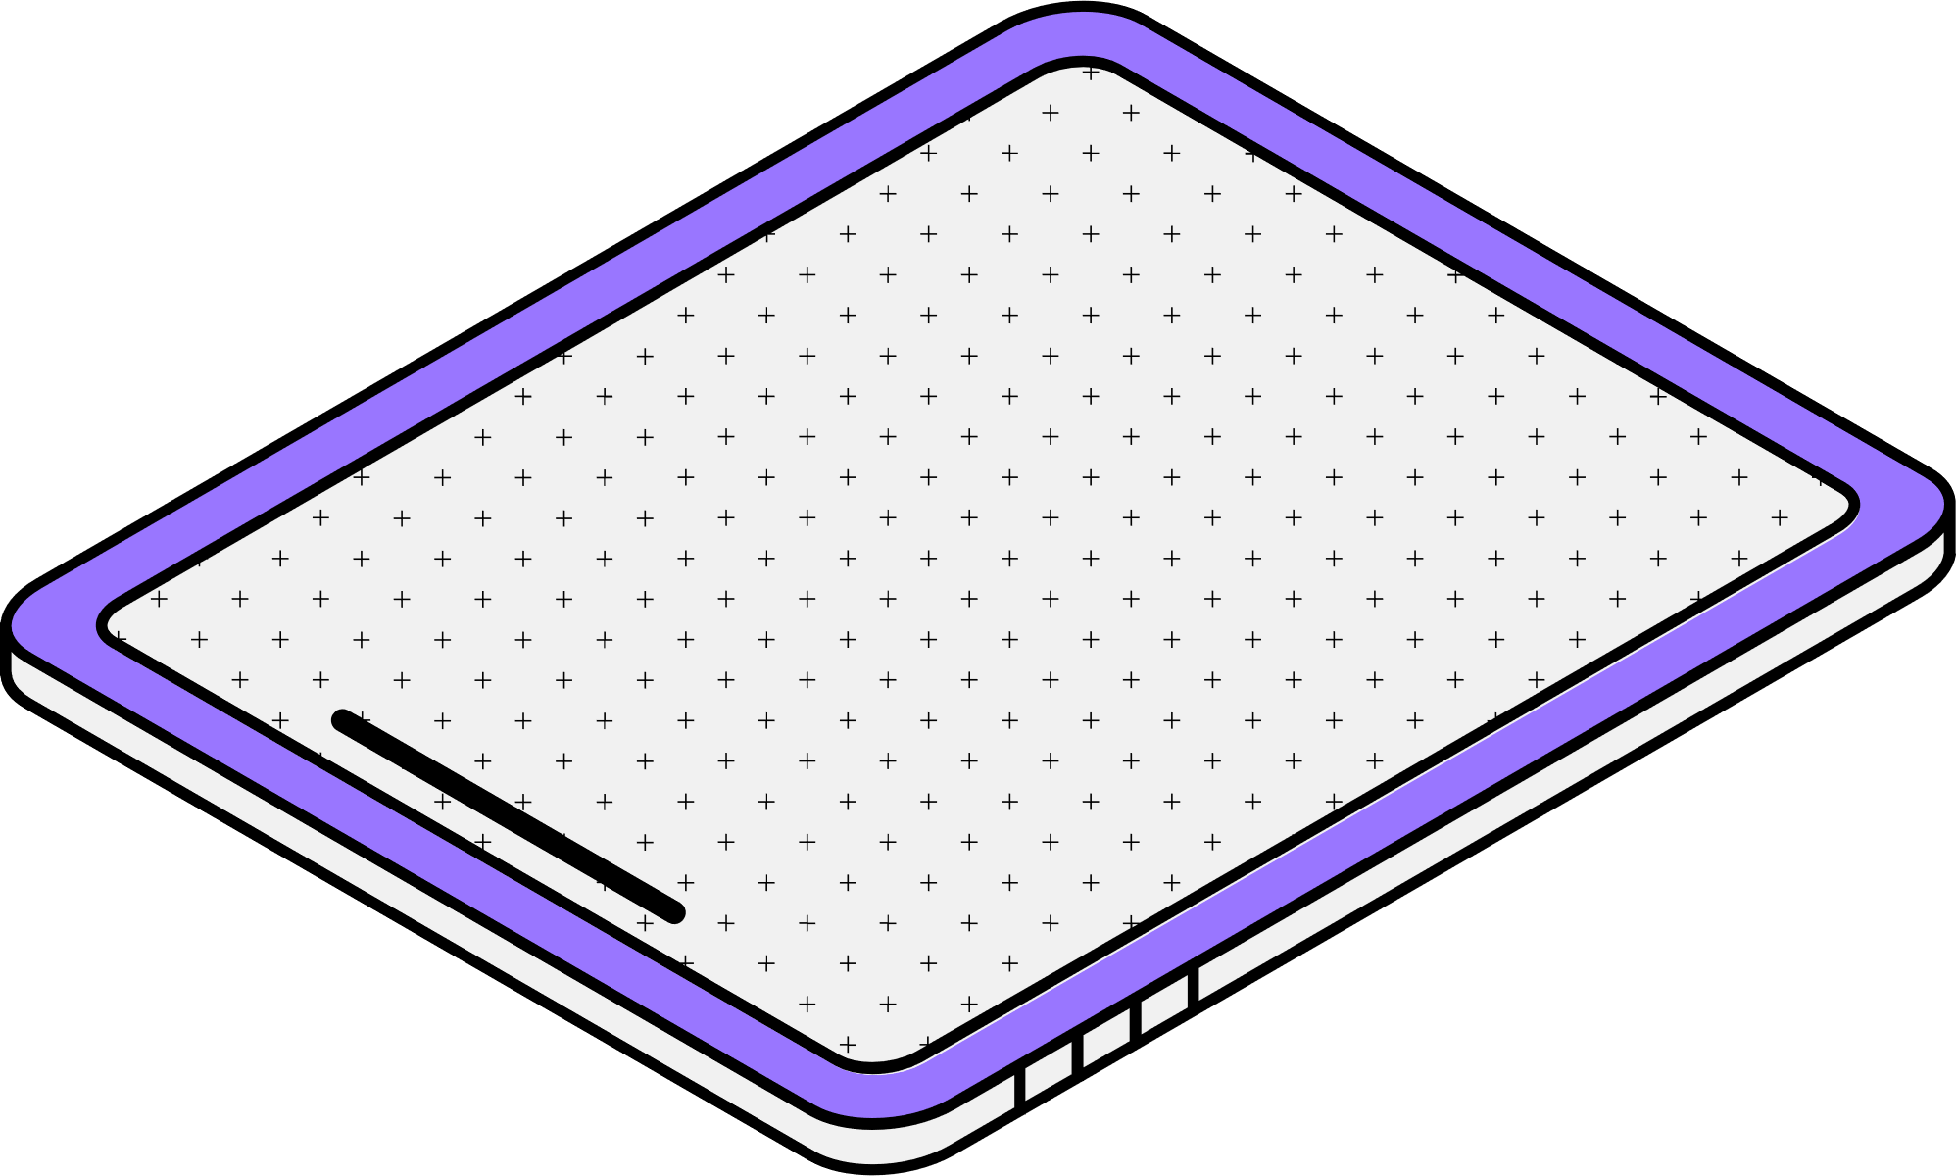
System Design

Slide 10
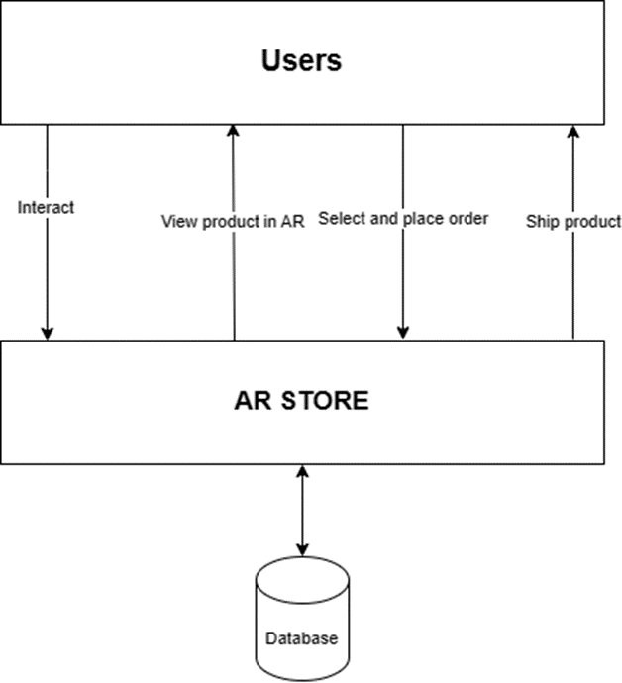
GENERAL
BLOCK DIAGRAM
AR STORE
Page 07

Slide 11
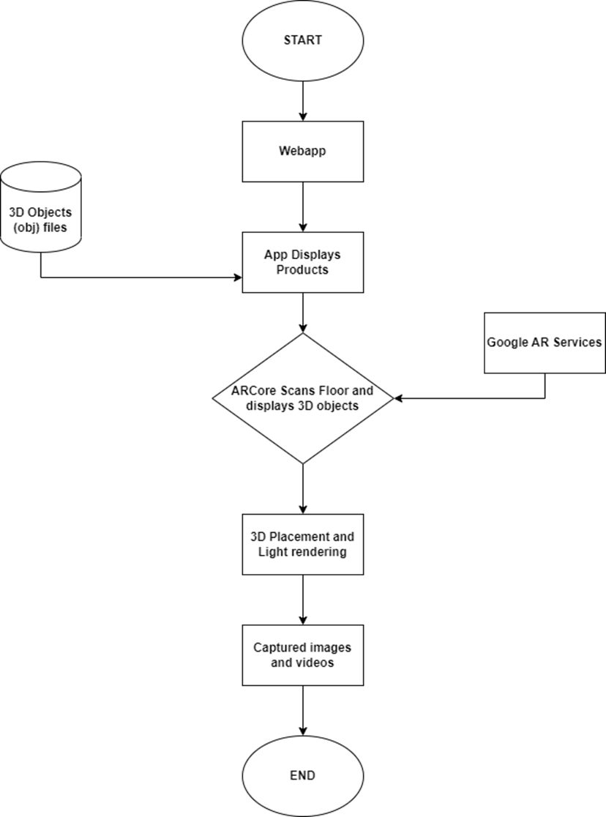
GENERAL
FLOW CHART
AR STORE
Page 08

Slide 12
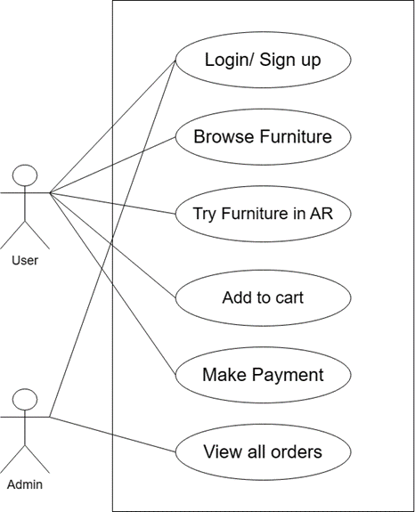
USE CASE DIAGRAM
AR STORE
Page 08

Slide 13
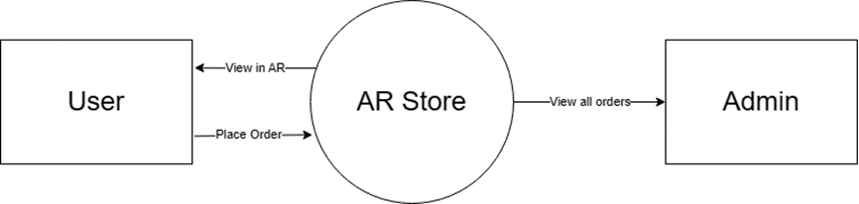
DFD
LEVEL 0
AR STORE
Page 08

Slide 14
DFD
LEVEL 1
AR STORE
Page 08

Slide 15
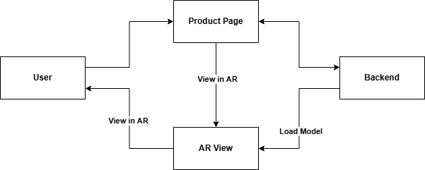
DFD
LEVEL 2
AR STORE
Page 08

Slide 16




KEY ADVANTAGES
Enhanced Visualization
Increased Customer Confidence
Provide customers with an unparalleled ability to visualize furniture in their living spaces, aiding decision-making.
Boost customer confidence by allowing them to experience products in a realistic setting before purchase.
Reduced Return Rates
Competitive Differentiation
Lower product return rates by setting accurate expectations and eliminating sizing or fit concerns.
Gain a competitive edge by offering a unique and innovative AR-powered shopping experience.
Page 09

Slide 17


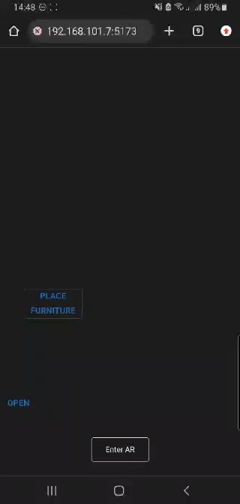
AR STORE
Product DEMO

Slide 18



Future Work
Future of shopping at AR Store
AR for Interior Design
Personalized AR Shopping Experiences
AR-Powered Virtual Showrooms
Leverage AR for interactive interior design and home decor planning, enabling customers to visualize complete room transformations.
Implement personalization algorithms to tailor AR experiences based on customer preferences and browsing history.
Create immersive virtual showrooms with AR, enabling customers to explore and interact with products in a simulated environment.
Page 11

Slide 19

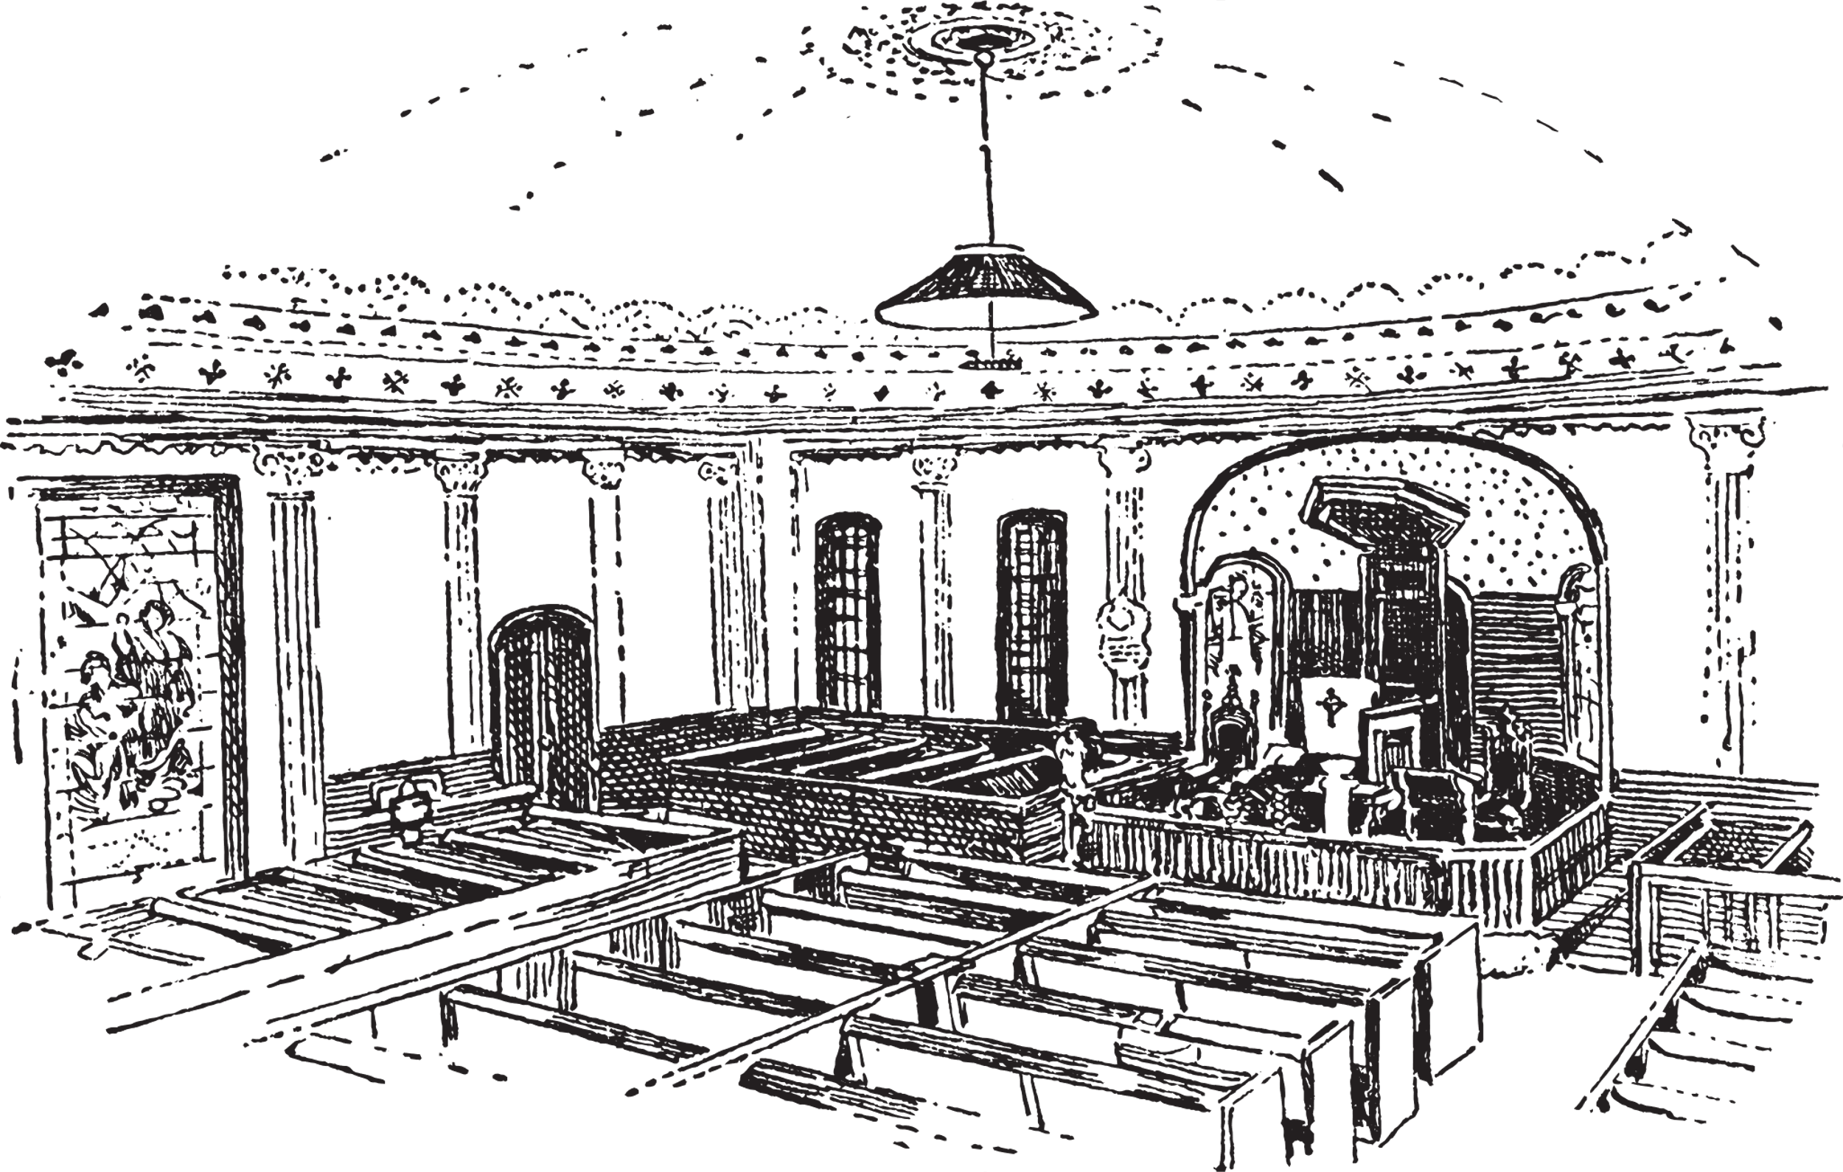
Conclusion
Our project integrates augmented reality into ecommerce, enhancing the furniture shopping experience. Despite challenges, we've successfully met objectives and optimized performance. We're excited about the platform's potential to revolutionize online shopping and exceed customer expectations. Overall, we're proud of our accomplishments and eager to see the impact of our project in the ecommerce industry.
Page 12

Slide 20

Do you have any questions?
Thank You!

